Slide 1
Jermyn Borough Council Meeting
3/17/22

Slide 2
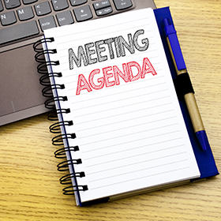
Meeting Agenda
March 17, 2022
• CALL TO ORDER
• PLEDGE OF ALLEGIANCE
• ROLL CALL
• PREVIOUS MEETING MINUTES
• TREASURER REPORT/BILLS PAYABLE
• CORRESPONDENCE
• PUBLIC COMMENT
• PROFESSIONAL REPORTS
POLICE
FIRE
EMA
SOLICITOR
CODE ENFORCEMENT
ZONING
ENGINEER
TAX COLLECTOR
MAYOR
COMMITTEE REPORTS
• SELF STORAGE AREA ROAD
• DAYCARE PARKING LOT
• LSA GRANT RESOLUTION
• POLICE PENSION ORDINANCE
• NEW BUSINESS

Slide 3
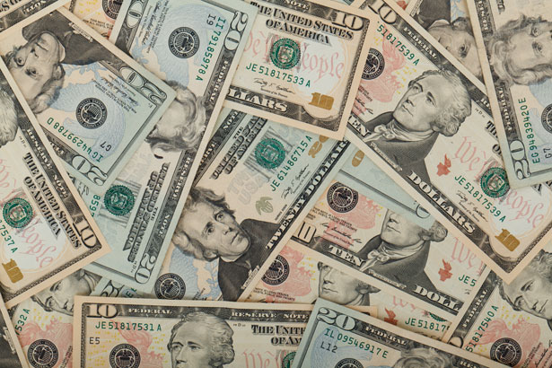
Treasurer’s report
3/17/22
ASSETS
Checking/Savings
Capital Reserve - DPW 10,725.94
Capital Reserve - Police 4,621.82
Crime Watch Fund 222.69
General Fund - Community 180,227.83
General Fund - FNB 4,506.15
Holiday Lights Fund 1,374.09

Slide 4
Treasurer’s report
Investment - General Fund 1,001.62
Investment - Liquid Fuels 33,817.03
Investment - Paving Fund 1,011.98
Investment - Recycling 5,003.86
Investment - Refuse 2,600.44
Liquid Fuels - FNB 66,755.07
Petty Cash 231.00
Recreations Fund 18,234.92
Recycling - Community 10,063.44
Refuse Checking - FNB 6,019.78
Total Checking/Savings 346,417.66

Slide 5
Treasurer’s report
200000 · Accounts Payable 29,099.91
Long Term Debt 328,205.34

Slide 6
MS4 Minute
https://www.youtube.com/watch?v=hvbhK5WfoSs

